Slide 1
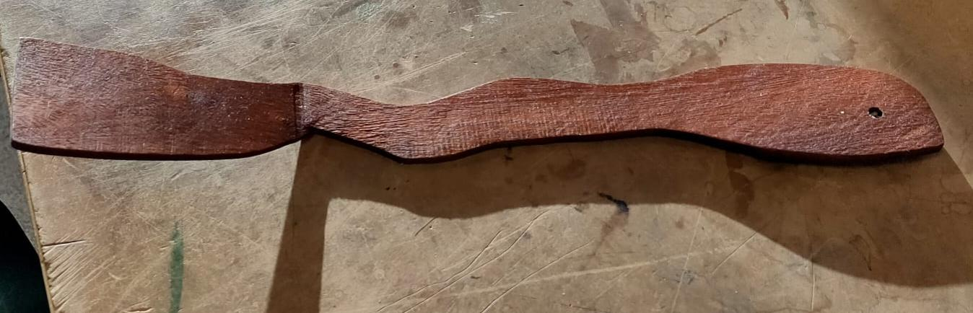
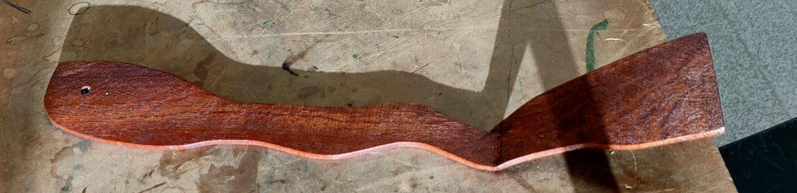
Salad Servers
Leon Sandhu 12MA

Slide 2
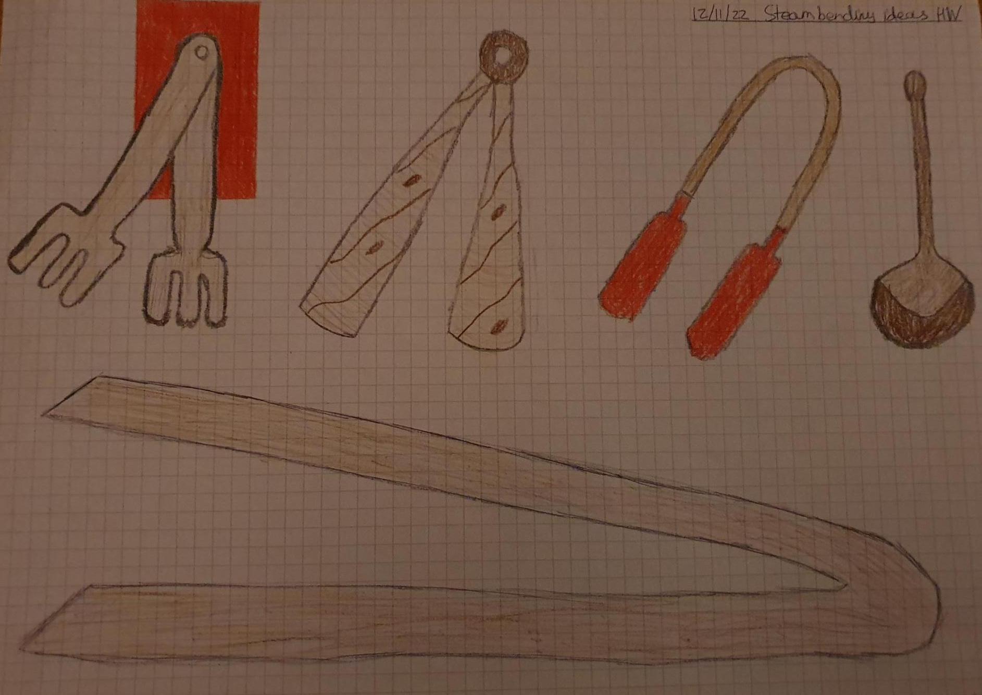
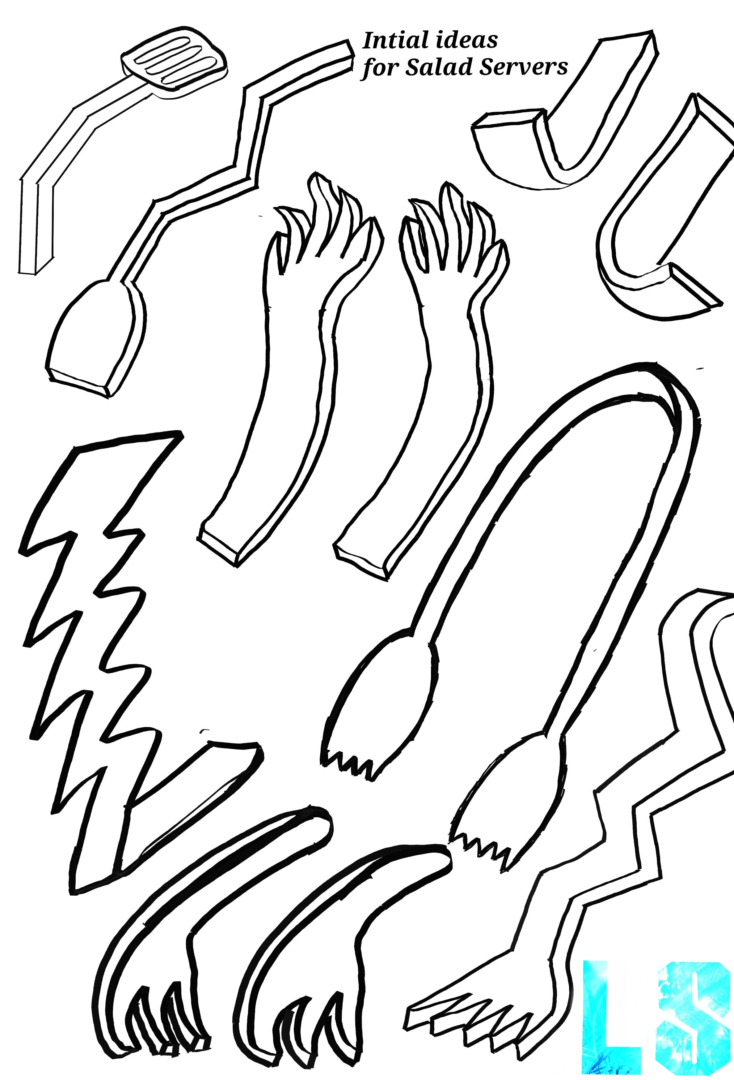
Initial ideas (brainstorming)
First I brainstormed some ideas on a piece of paper and rendered them to make them stand out a bit more. Out of all the paper ideas, my favorite was the 3rd one which i had imagined to be 1 piece of wood steam bend all the way around with some sort of silicon hands attached to the end for aesthetic appeal and to give more grip to the whole product. I then concluded that if would be incredibly hard to do and that smaller bends were the only ones i could really do so i created some more ideas, this time digitally, keeping some of the same ideas but also creating much different ones

Slide 3
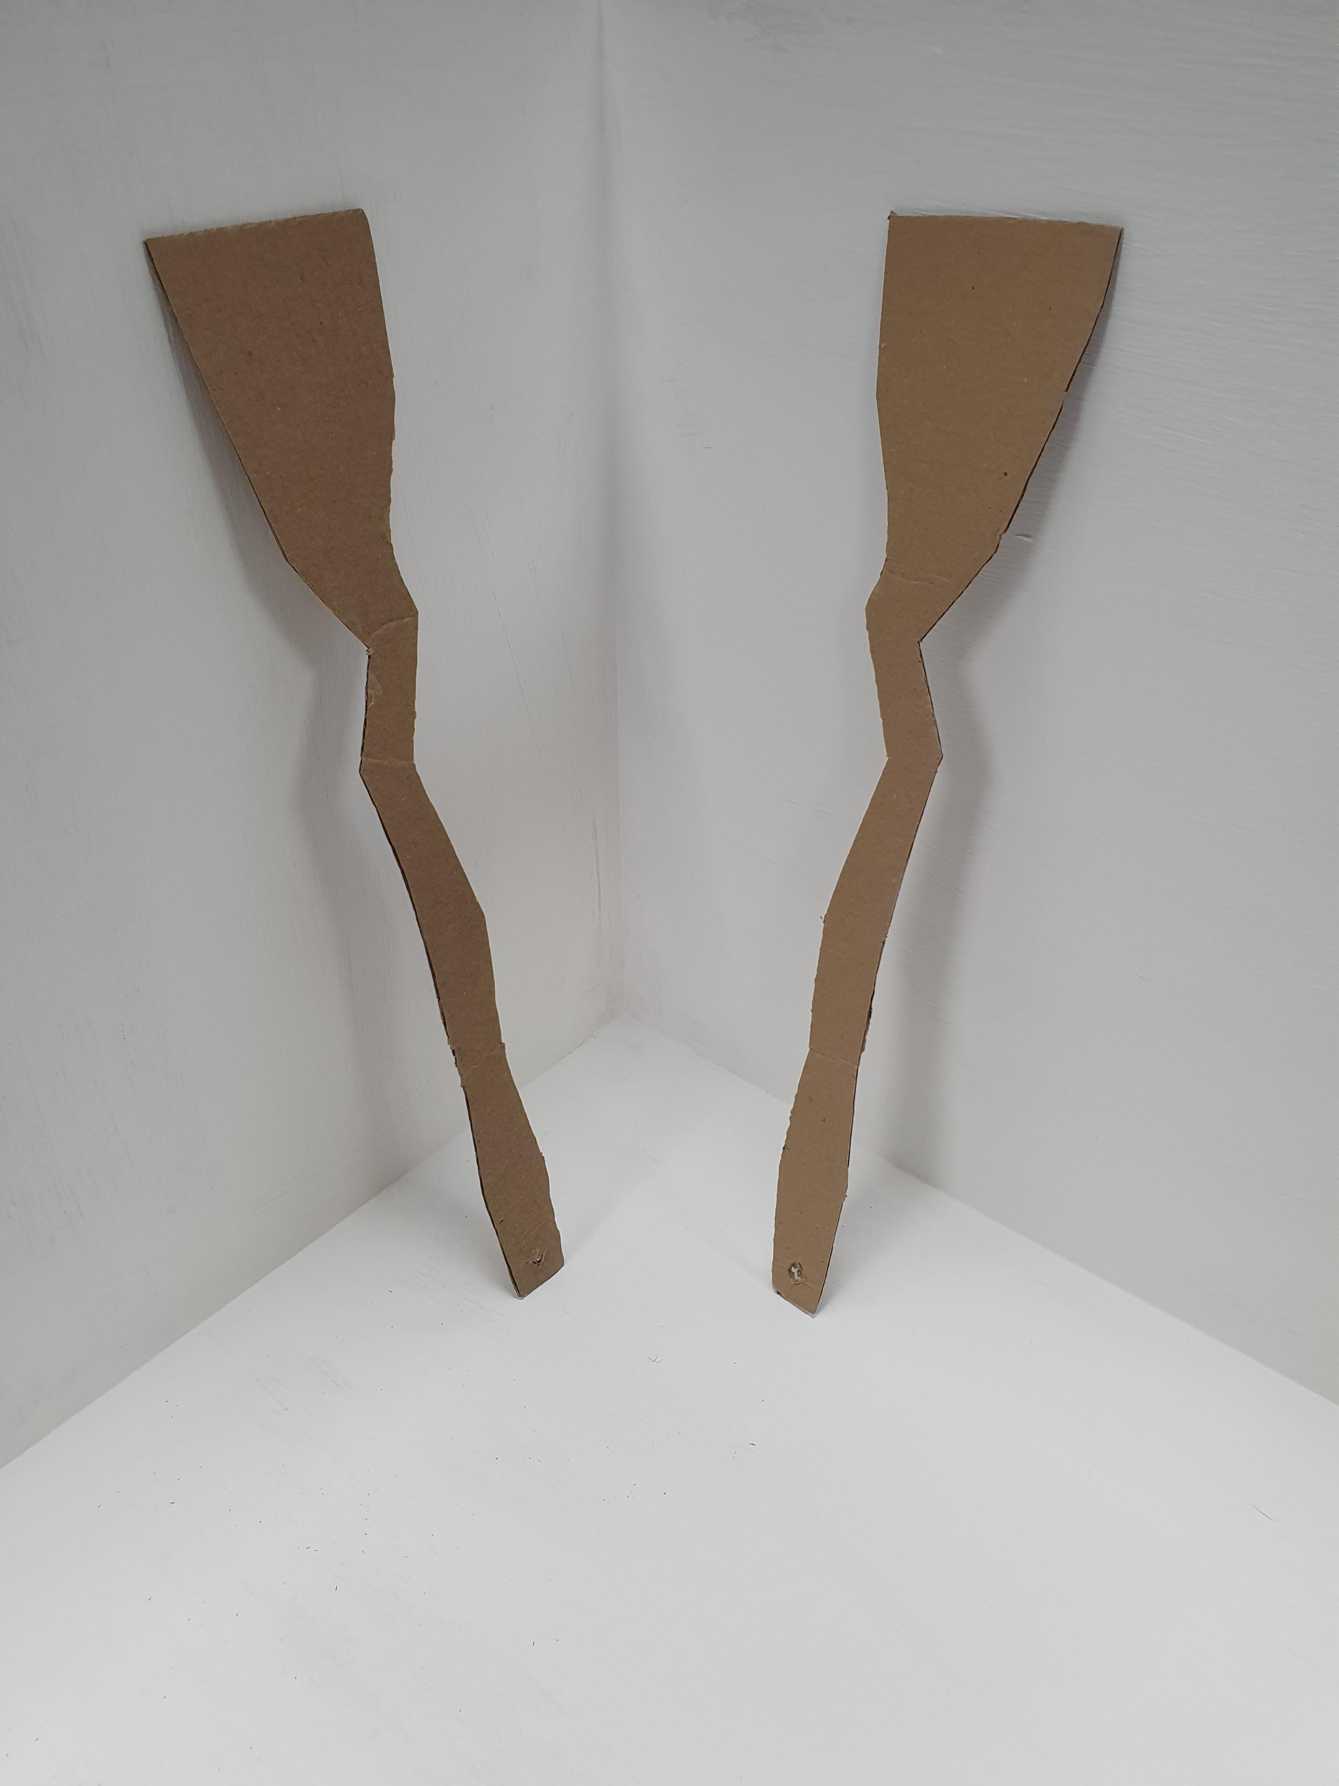
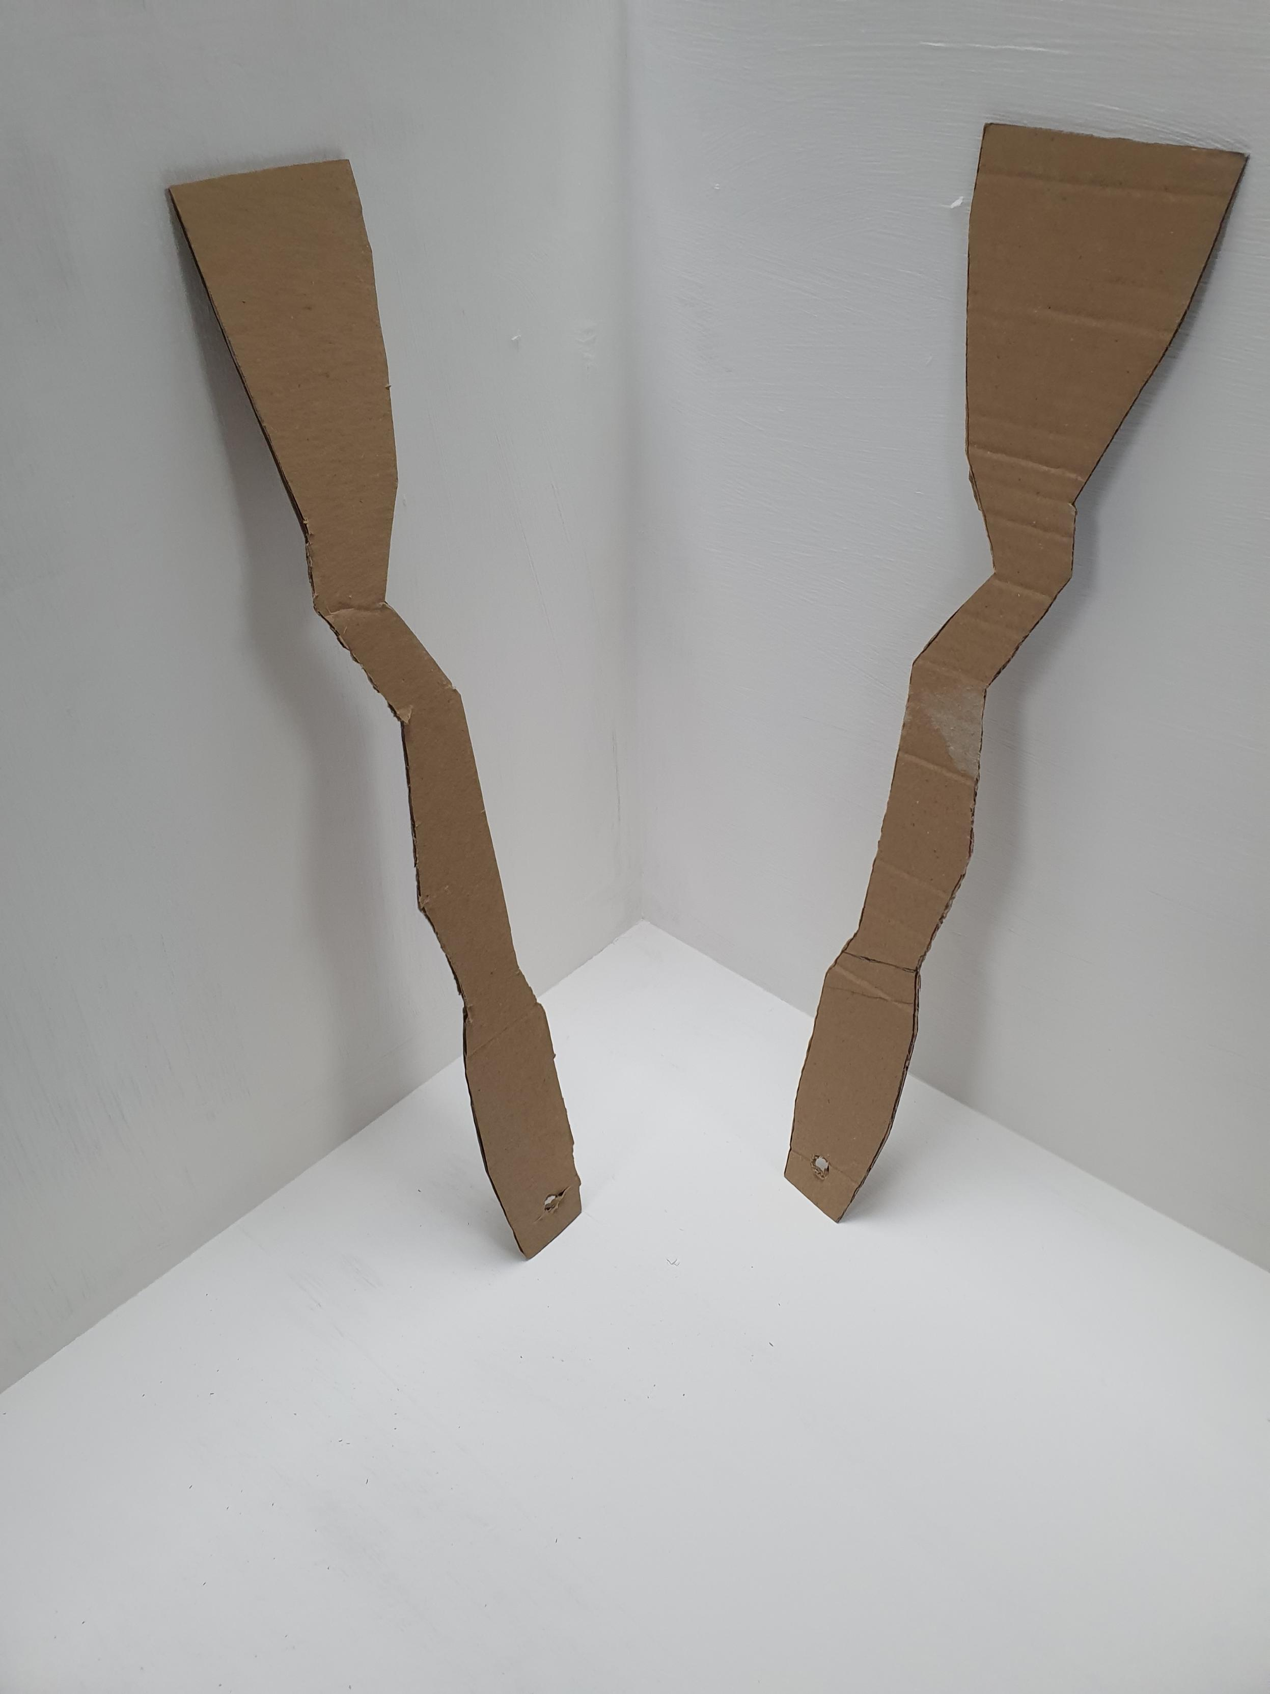
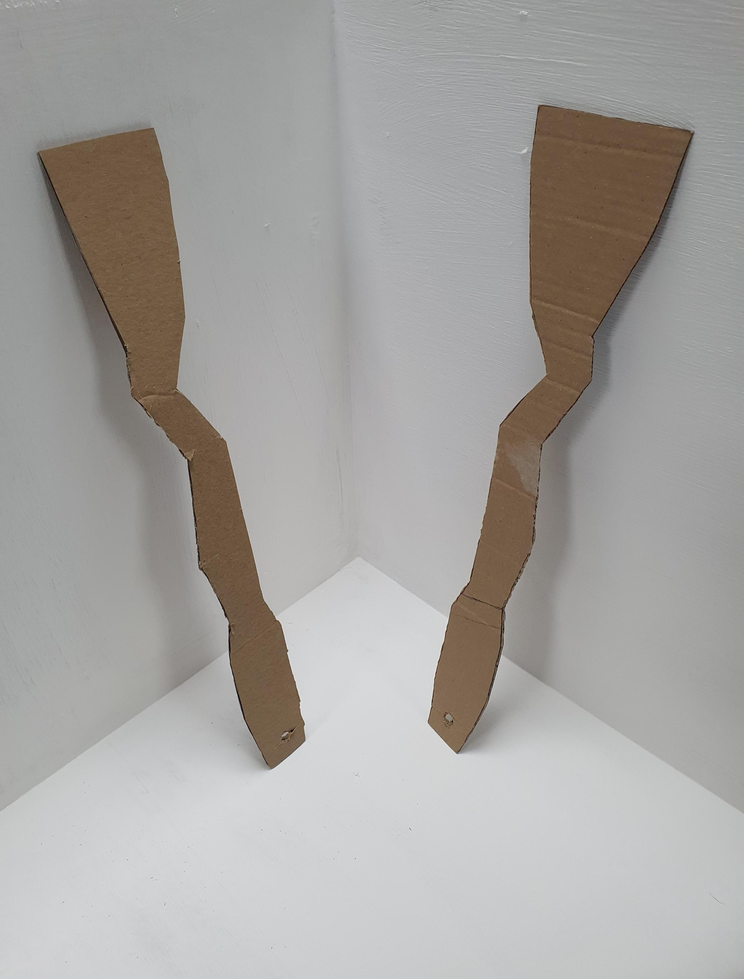
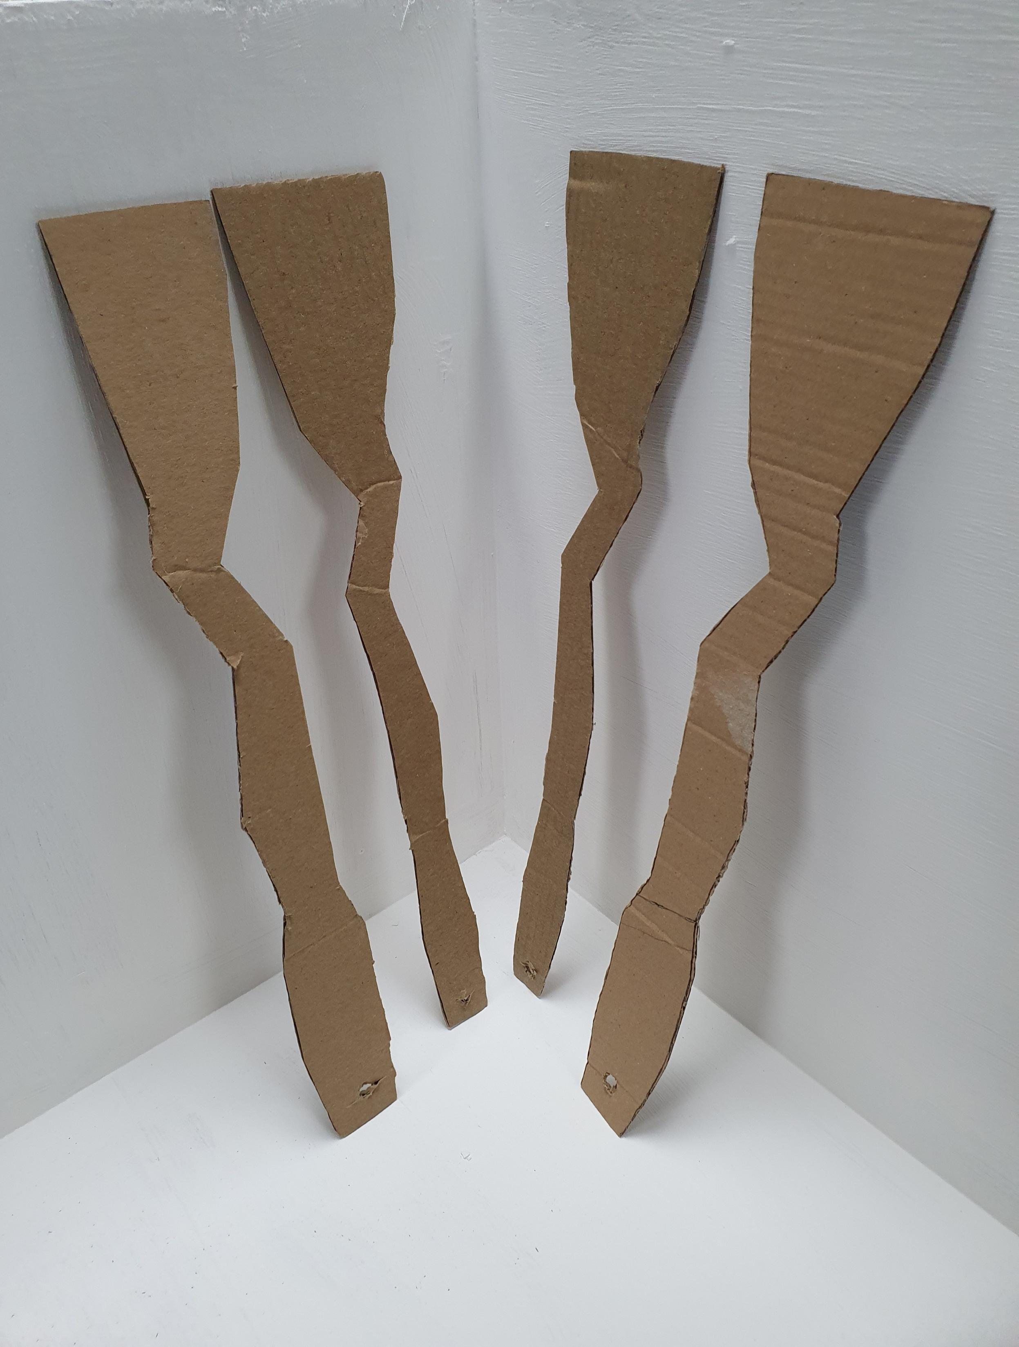
Making the salad server
Once i had decided what design I wanted to test, i created cardboard models to see for myself how it could feel and work as a physical model. So using some markers and scissors, I created these cardboard models and using some pretend food to test if it could move objects around effectively, I realised that it was too thin in certain parts and that it could snap quite easily when I end up steam bending it. So, I created more cardboard models but this time slightly wider around the areas I identified that could have a problem before. These I was happy with after the same sort of testing and so I decided to move on to the wooden design
Using my cardboard model as a stencil I created the same shape with tools and machinery such as the bandsaw, band face, coping saws and sand paper. Once I finalised that the edges were as smooth as they could be, it was time to use the steamer.
Once, in the steamer I selected two moulds that I thought would be the most effective and once the design was out of the steamer, I quickly place it in the jig and using the vice tightened it in place to be left to dry and set

Slide 4
Evaluation
Overall I think my product came out ok, it would’ve been more functionable as a pair- but unfortunately one of them did break during the steam bending to circumstances outside of my control. However being a sole piece as allowed it to not only take up less space but to also have other functions that I wasn’t initially planning (e.g. Flipping an egg or pancake or moving food off the grill) which is a happy coincidence. Aesthetically speaking however I wished I would of chosen a more creative design and I think it could’ve turned out much better not only in terms of attractive ness but also in terms of function, so if I did do this this again that is one thing I would probably change. The quality ifs pretty good of the remaining piece, it finishes up nicely with the oil (which I used to make it waterproof for washing and food safe) and all edges were smooth and felt nice to touch so overall id say Ive relatively happy with how things turned out

